Slide 1

DATA VISUALIZATION ON SUPERSTORES SALES DATASET

Slide 2
SECTION 1
Introduction: In this report, it consist of data visuals and dashboards of the sales data of a fictional superstore using Power BI. Power BI is one of the most popular data visualization, business intelligence tool. This report explores and provides valuable insights of the dataset with various visualizations.
Link to Data: [Link to Dataset]
Why Selected: We selected this departmental store sales dataset due to its relevance for business analysis. Sales data offers insights into a company's performance and provides opportunities for optimization and decision-making.

Slide 3
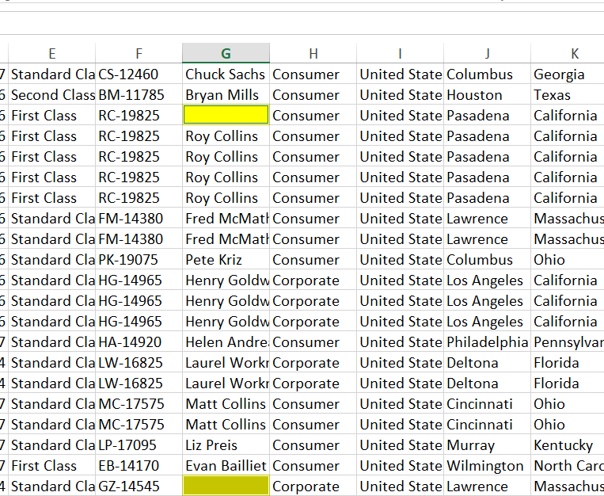
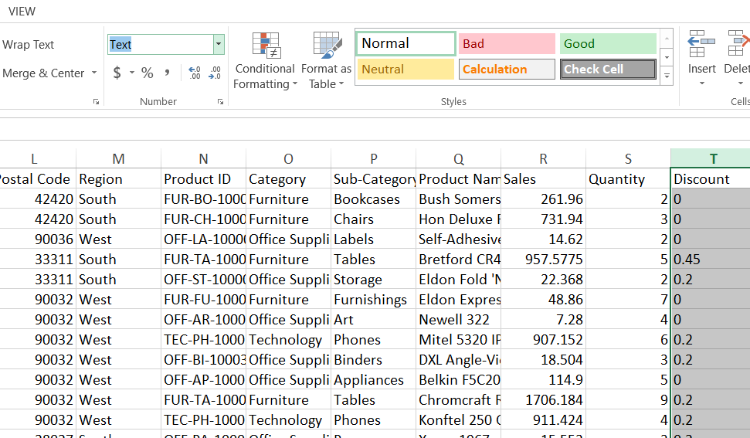
Issues in Data: During the analysis, we encountered several data issues. We found null values in some columns, which needed to be removed for accurate analysis.
We changed numerical columns from text format to number format to ensure mathematical operations were possible.
We also identified and removed incorrect values, such as 'a^' in discount rows.
These data cleaning steps were essential to ensure the accuracy and reliability of our analysis.

Slide 4

Section2: Selected Analysis/Visualization Tool
Beneifits
Drawbacks
Increased Reach
Cost Savings
Personalization
Data-driven Insights
Security concerns
Dependency
Customer service challenges

Slide 5
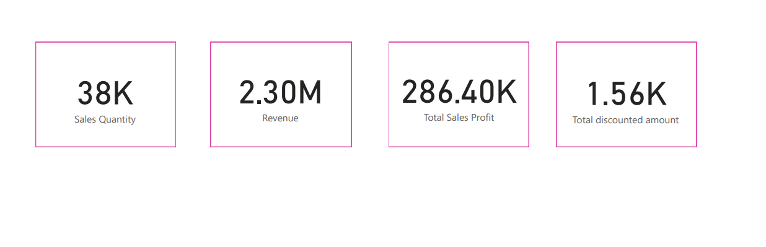
Section 3: Visualizations (Diagrams)
Name card visual: This Name Card visual provides a comprehensive overview of key metrics, including sales, quantity, revenue, profit, and discounted amount for the country US. Name card visual is useful to show a single numerical value or a metric value of a number.

Slide 6
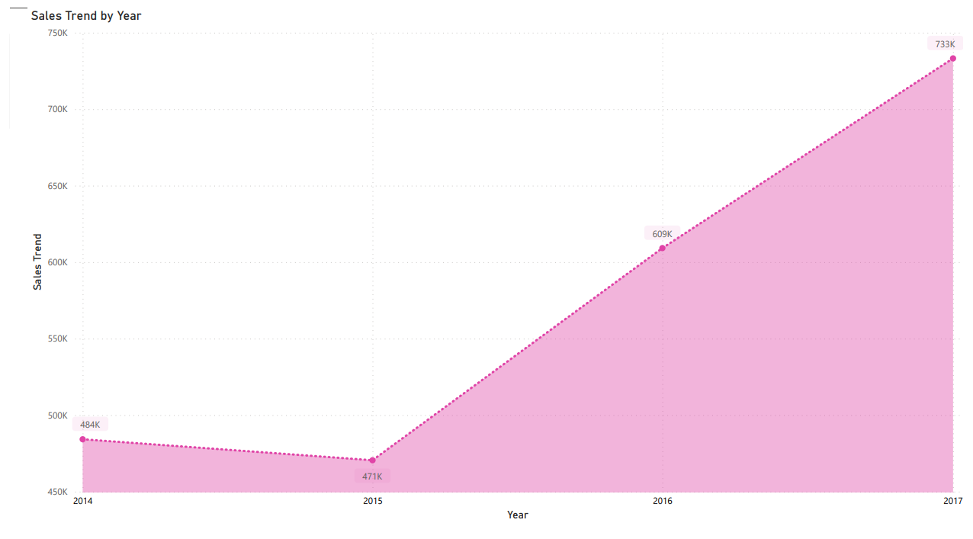
Line Chart
This Line Chart illustrates sales trends by year for various states. It provides a year-by-year breakdown of sales performance, allowing us to identify any patterns or seasonality in sales data. For instance, it indicates that sales have been steadily increasing after 2015 in all states.

Slide 7
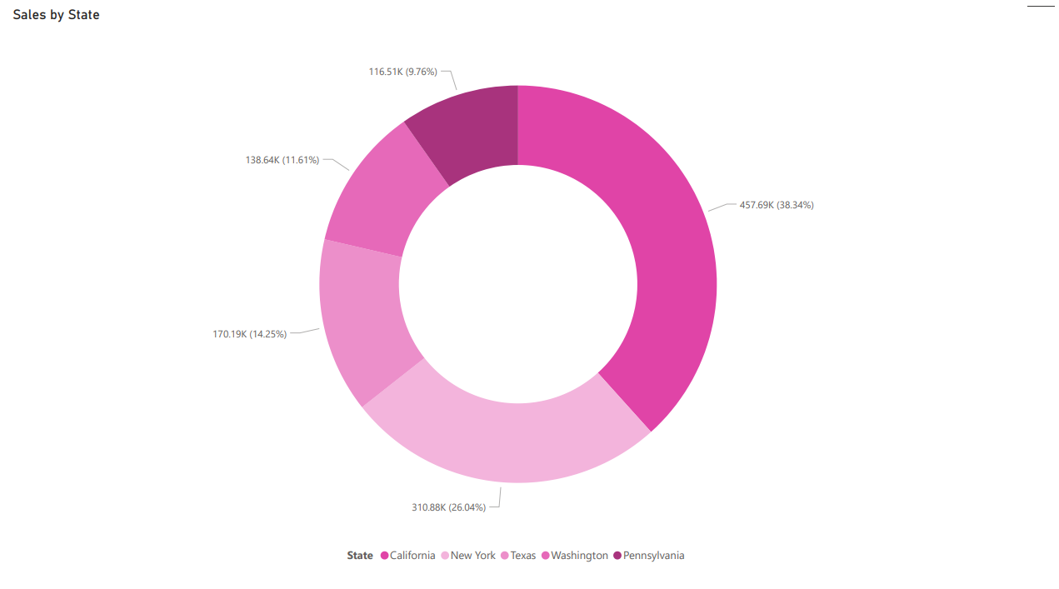
Pie Chart
The Pie Chart focuses on the top 5 sales states. It visually represents the proportion of total sales contributed by these top-performing states. California, New York, Texas, Washington, and Pennsylvania, are the top 5 states contributing significantly to the overall sales revenue.

Slide 8
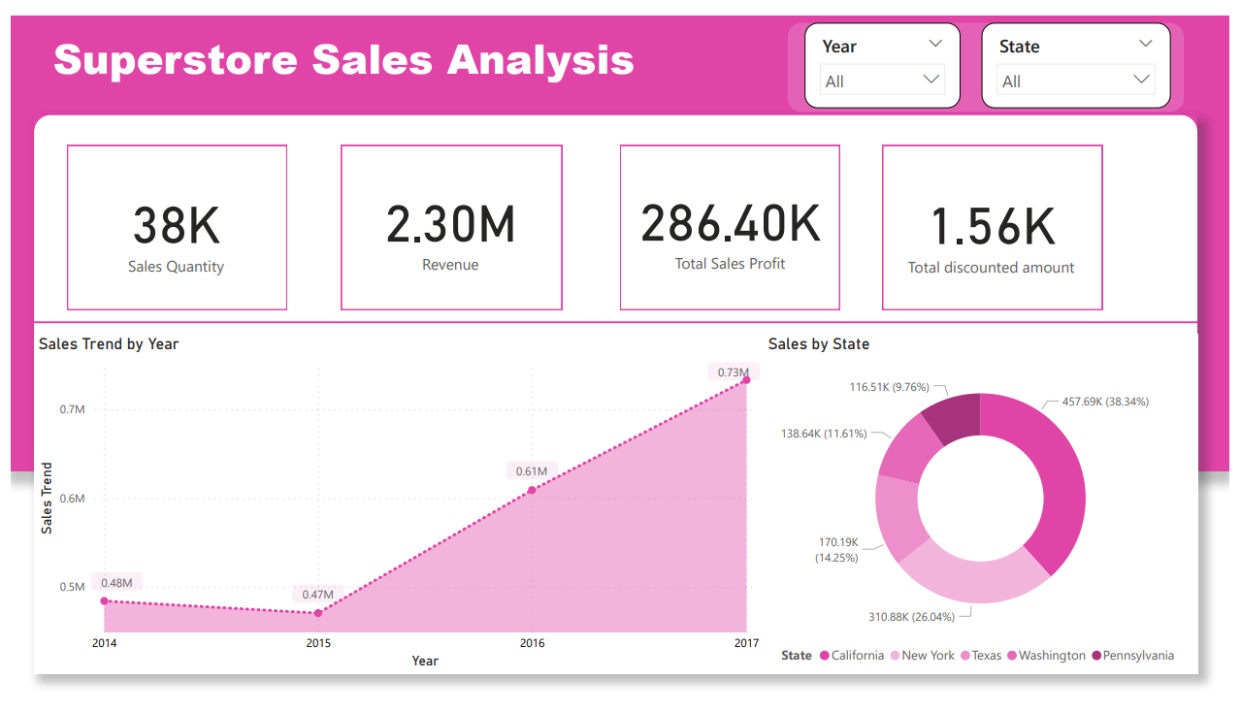
Sales Analysis Dashboard
The Sales Analysis Dashboard is designed to provide a visual and interactive summary of key sales metrics to gain quick insights into the performance of the departmental store data. It helps in tracking sales trends, identifying top-performing states in specific state. The dashboard features multiple visualizations and interactivity for a comprehensive sales analysis.

Slide 9
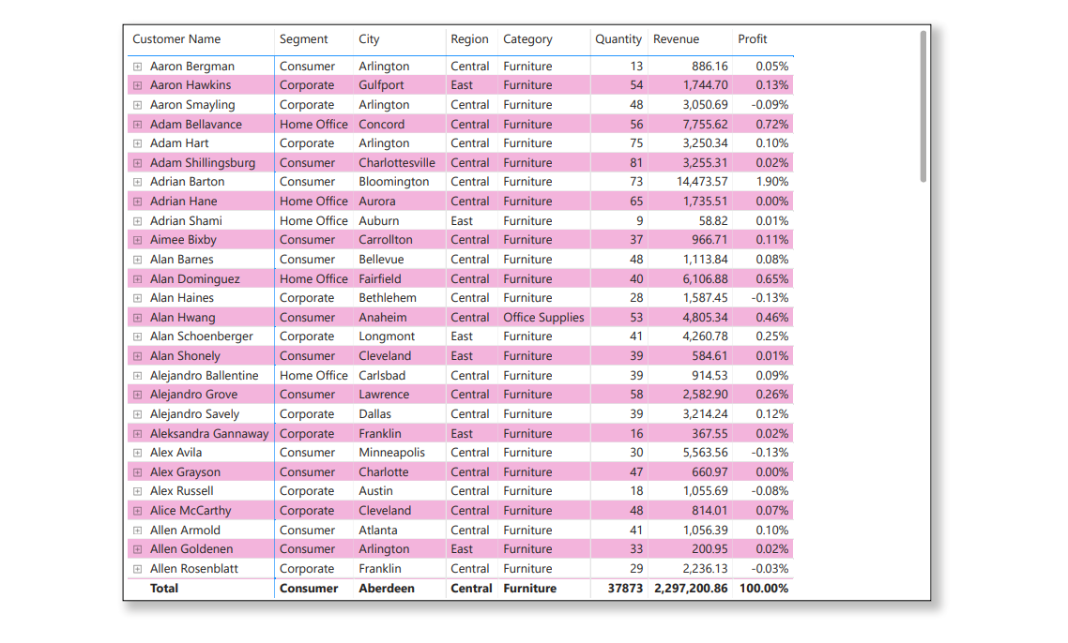
Matrix Visualization
The Matrix displays customer details, including their names, segments, City, Region, Category, Revenue, Profit, and the number of orders. It helps us identify high-value customers for potential targeted marketing efforts.

Slide 10
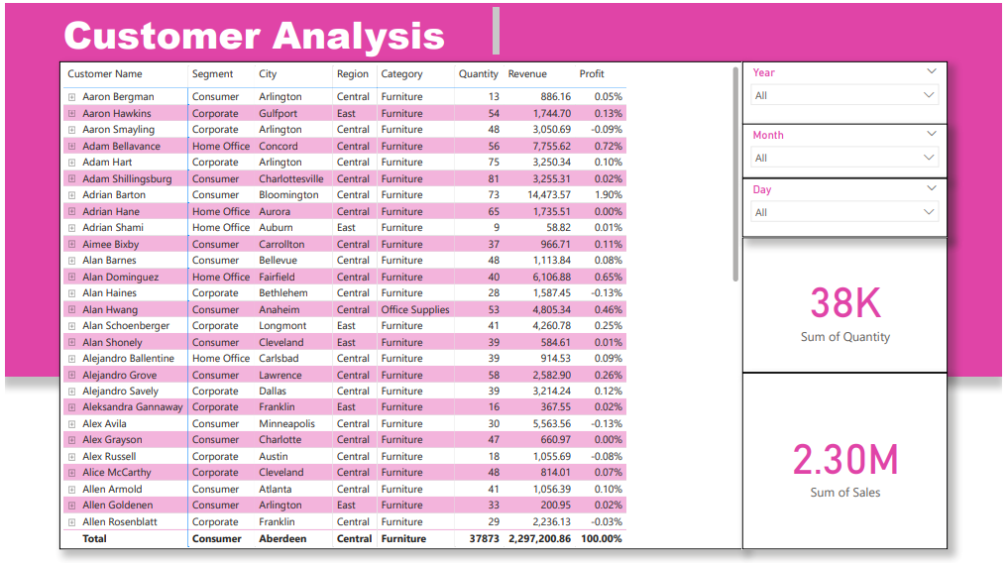
Customer Analysis
The Customer Analysis Dashboard features a Matrix visualization that insights into customer profiles, including their names, segments, City, Region, Category, Revenue, Profit, and the number of orders. It provides a dynamic slicer for year, month, and day, enabling users to filter data by specific time frames. The Name Card visuals for sales and revenue present key performance metrics at a glance, and a quick assessment of customer-related insights.

Slide 11
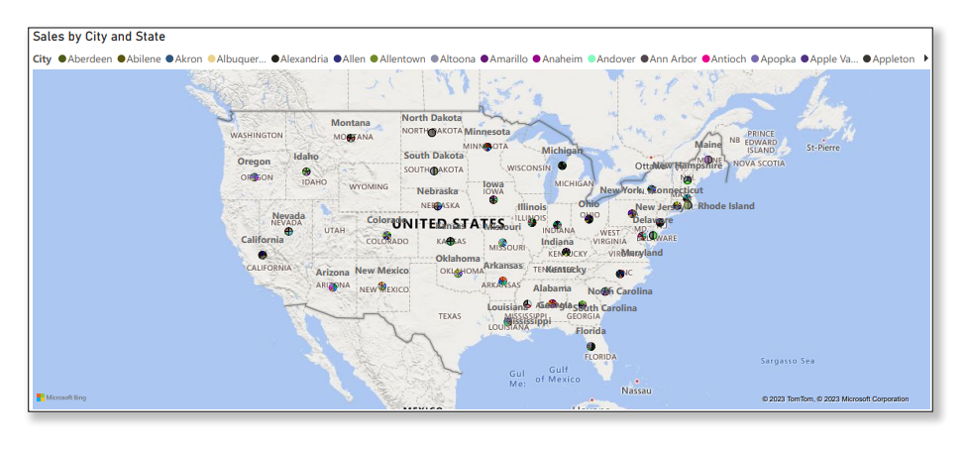
World Map Visualization
The world map visualization displays sales data by city and state, offering a geographical view of sales distribution. It enables users to easily identify the variations in sales across different cities and states, providing a global perspective on the departmental store's performance.

Slide 12
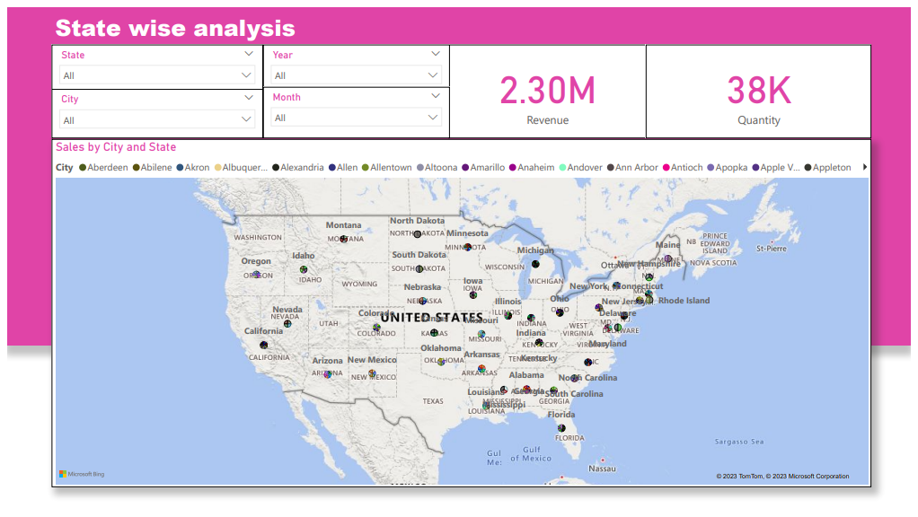
State Wise Analysis Dashboard
The State-Wise Analysis Dashboard leverages a world map visualization, displaying sales data by city and state. The inclusion of slicers for selecting specific states, cities, years, and months offers dynamic data filtering capabilities. Furthermore, Name Cards for sales, quantity, and revenue provide concise summaries of key performance metrics.

Slide 13
Section4: Findings
Sales Analysis
Customer Analysis
Sate-wise Analysis
The "Name Card" visual provided a quick overview of key metrics.
The "Line Chart" revealed a steady increase in sales in after 2015.
The “Pie Chart” visual represents the distribution of total sales with California, Texas, and New York as the top contributors, suggesting consistent growth in these states.
The "Matrix Visualization" offered detailed customer profiles, helping identify high-value customers and segments for targeted marketing efforts.
The majority of customers fall within the Consumer segment, with the Corporate and Home Office segments also well-represented.
The world map visualization presented a clear geographical view of sales data, allowing users to analyze sales by city and state.
The slicers for state, city, year, and month offered interactive filtering options to drill down into specific data subsets.
Name Cards for sales, quantity, and revenue made it easy to grasp key metrics at a glance.

Slide 14
Limitations
Scope limitation : The analysis primarily focused on basic sales data and key performance metrics. More complex analyses, such as predictive modeling or deeper customer segmentation, were not included.
Data Size limitation : Power BI face performance issues with very large datasets. For extensive data analysis, consider potential data size constraints.
Data Quality : While data cleaning steps were taken to address null values, incorrect values, and data format issues, data quality can impact analysis accuracy.
Conclusion
This report provides a valuable insights of the Superstore sales data to gain data-driven insights. With various interactive dashboards users can able to gain specific information about the data. Overall these report analyze data issues, explore data insights, and provide assist in decision making to improve business.

